Slide 1


Automotive Examples of different types of controllers in control systems

Slide 2


Agenda
Open Loop control system
Closed Loop Automation
3
Linear Quadratic Regulator (LQR)
H – infinity

Slide 3

Open Loop control system

Slide 4
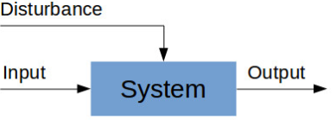
Open Loop control system:
Those systems in which the output has no effect on the control action are called Open-loop control system.
In open loop system, the output remains constant for a a given input provided the external conditions are same.
There is no connecting feedback in Open loop system.
For example:-Acceleration control system
Open-loop Engine Control Systems
Fig 1.open loop system
Source:https://what-when-how.com/automobile/open-loop-engine-control-systems-automobile/

Slide 5
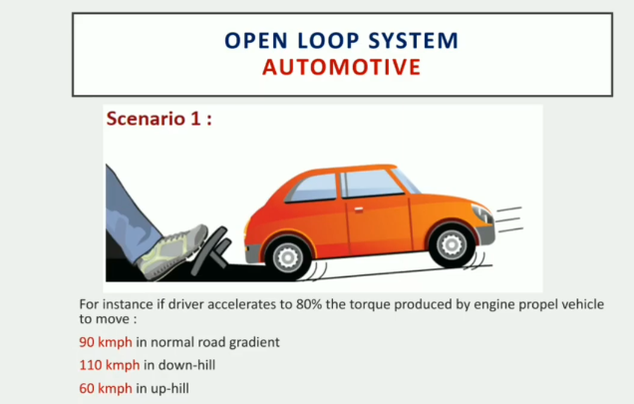
Open loop system in Automotive:-
Fig 2.Accelerator scenario
Observation:-even if the accelerator pedal position is same but depends on road gradient the vehicle speed keeps on changing without any controller
Source:-https://x-engineer.org/graduate-engineering/signals-systems/control-systems/open-loop-vs-closed-loop-control-systems-xcos/

Slide 6
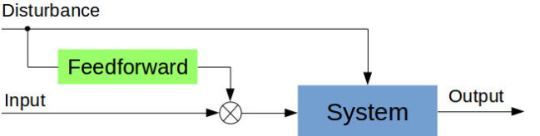
Open loop (feedforward) control system:-
Fig 3.Feed forward
We can have an open loop control system which can adjust it’s input based on known disturbances. This control systems are called feedforward control systems.
Feedforward control system rely on the calibration of the feedforward part. This is usually done after some test or measurements have been performed with the system subject to disturbances
Source:https://www.sciencedirect.com/topics/engineering/feedforward-control

Slide 7
Closed Loop Automation

Slide 8
Closed Loop System
A closed loop control system is a set of mechanical or electronic devices that automatically regulates a process variable to a desired state or set point without human interaction.
Unlike Open loop System, it doesn't require manual input.
It uses feedback. That is, either the output or the part of the output is returned to the input side and utilized as a system input.

Slide 9
Automated Examples on Closed Loop System
1. Sunseeker solar system
Sunseeker solar system is an automatic tracker which uses LDR to sense the sunlight. A microcontroller reads the LDR voltage and signals the connected motor which rotates the panel towards the sun.
Sunseeker solar system
Input | Sunlight
Plant | Solar Panel
Controller | µC
Output | Position change
SOURCE: https://www.electricalengineering.xyz/article/top-10-examples-of-closed-loop-control-systems-practical-applications/

Slide 10
Automated Examples on Closed Loop System
2. Auto Engine
The tachometer in auto engine generates a voltage proportional to the speed of the shaft. The voltage is subtracted from the input voltage to calculate an error voltage that provides information about current speed and desired speed. The error voltage is then used to arrange the throttle after amplification.
Auto Engine
Input | Desired speed
Plant | Auto Engine
Controller | Cruise system
Output | Change in speed
SOURCE: https://www.electricalengineering.xyz/article/top-10-examples-of-closed-loop-control-systems-practical-applications/

Slide 11
Automated Examples on Closed Loop System
3. Turbine Water Control System at power Station
In modern hydroelectric power stations, the level of water coming from the nozzles and gate is adjusted using automatic controls.
Turbine water control
Input | Flow rate of water
Plant | DAM
Controller | Governor sets
Output | Change of flow rate
SOURCE: https://www.electricalengineering.xyz/article/top-10-examples-of-closed-loop-control-systems-practical-applications/

Slide 12
More insights and Examples into the topic
Advanced Distribution Management Systems by NREL
https://youtu.be/ZeDxFKhpssg
Missile launching Control System
https://www.youtube.com/watch?v=zgAUABWNo28
Closed Loop Automation Overview
https://www.youtube.com/watch?v=fpJ8y1n30kA

Slide 13
MODEL PREDICTIVE CONTROL(MPC)

Slide 14
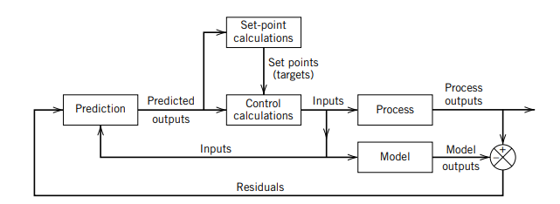
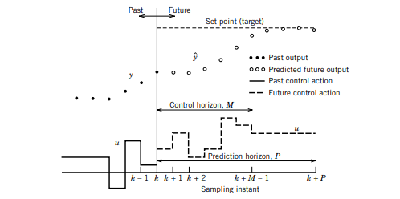
Basic Structure of MPC
•Model predictive control (MPC) is an advanced method of process control that is used to control a process while satisfying a set of constraints.
•The MPC calculations are based on current measurements and predictions of the future values of the outputs. The objective of the MPC control calculations is to determine a sequence of control moves (that is, manipulated input changes) so that the predicted response moves to the set point in an optimal manner
Basic concept of MPC
Basic Structure of MPC

Slide 15
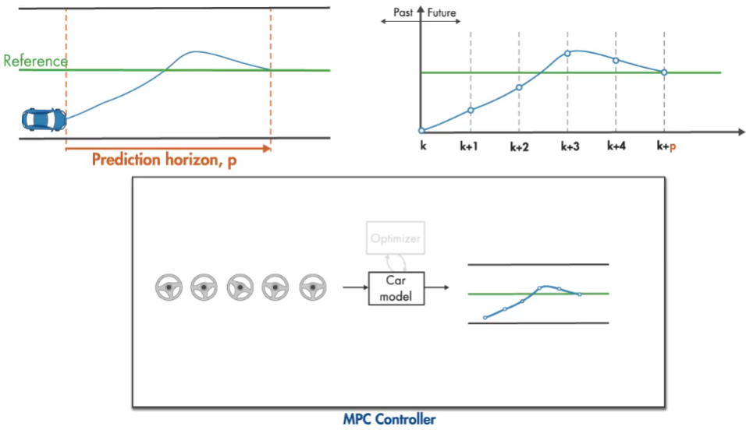
Example of MPC using a steering of car

Slide 16
Advantages of MPC
Model predictive control offers several important advantages:
the process model captures the dynamic and static interactions between input, output, and disturbance variables.
constraints on inputs and outputs are considered in a systematic manner.
the control calculations can be coordinated with the calculation of optimum set points.
accurate model predictions can provide early warnings of potential problems.

Slide 17
References
What is MPC
https://folk.ntnu.no/skoge/vgprosessregulering/papers-pensum/seborg-c20ModelPredictiveControl.pdf
For understanding go through
https://youtu.be/8U0xiOkDcmw

Slide 18
Linear Quadratic Regulator (LQR)

Slide 19

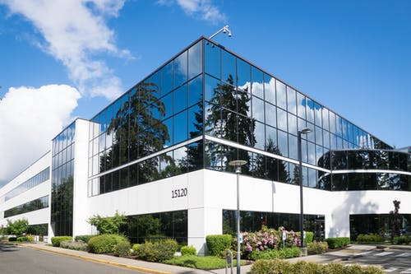
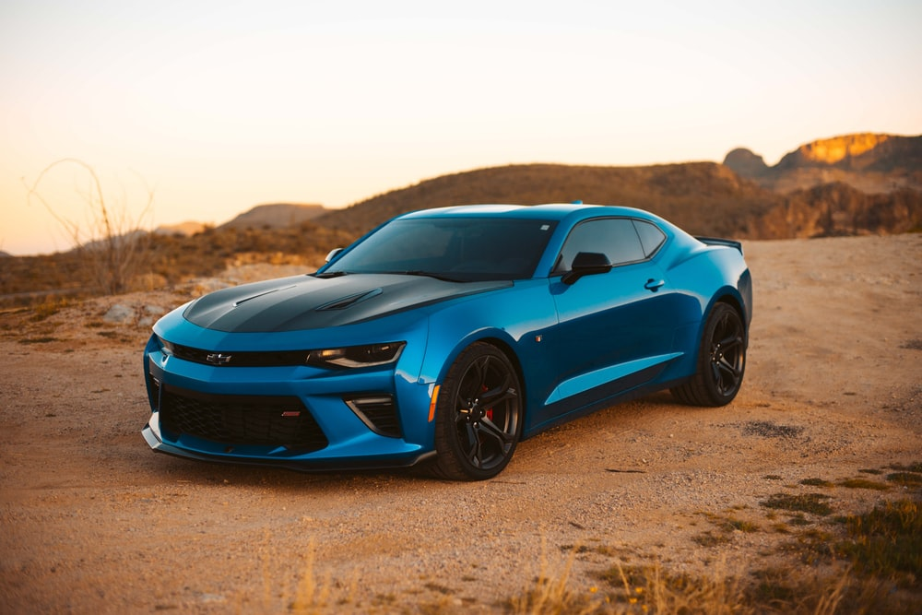
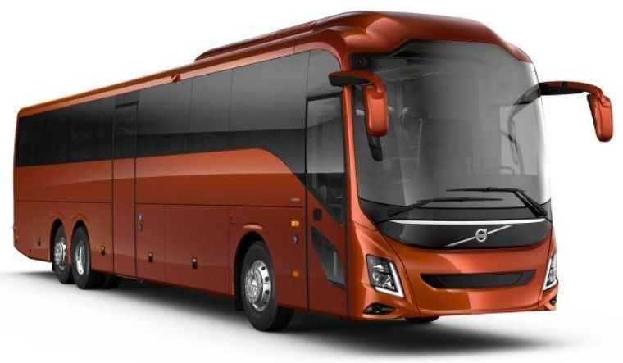
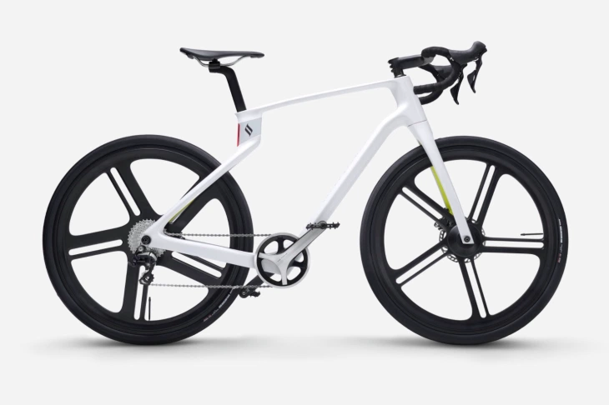

Linear Quadratic regulator
Initial Location: Desired Location
----
Cost function (Objective function), J = Q*Time + R*Cost
Method that provides optimally controlled feedback gains to enable the closed loop stable and high performance design of systems
System dynamics – Linear differential equations
Cost function - Quadratic function
Source : https://en.wikipedia.org/wiki/Linear%E2%80%93quadratic_regulator
OPTIONS??
Z
Cost
Function
J(Z)
Feasible sets
J

Slide 20
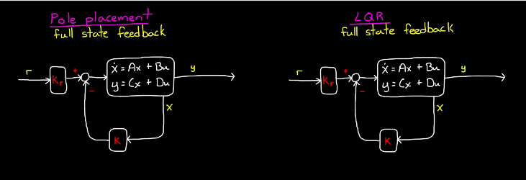

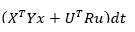
LQR vs Pole Placement technique
Determination of value of K (gain)
// Performance and effort optimization
U = -Kx // find optimal solution
X = Ax+Bu
Y = Cx+Du
Source : https://www.youtube.com/watch?v=E_RDCFOlJx4

Slide 21
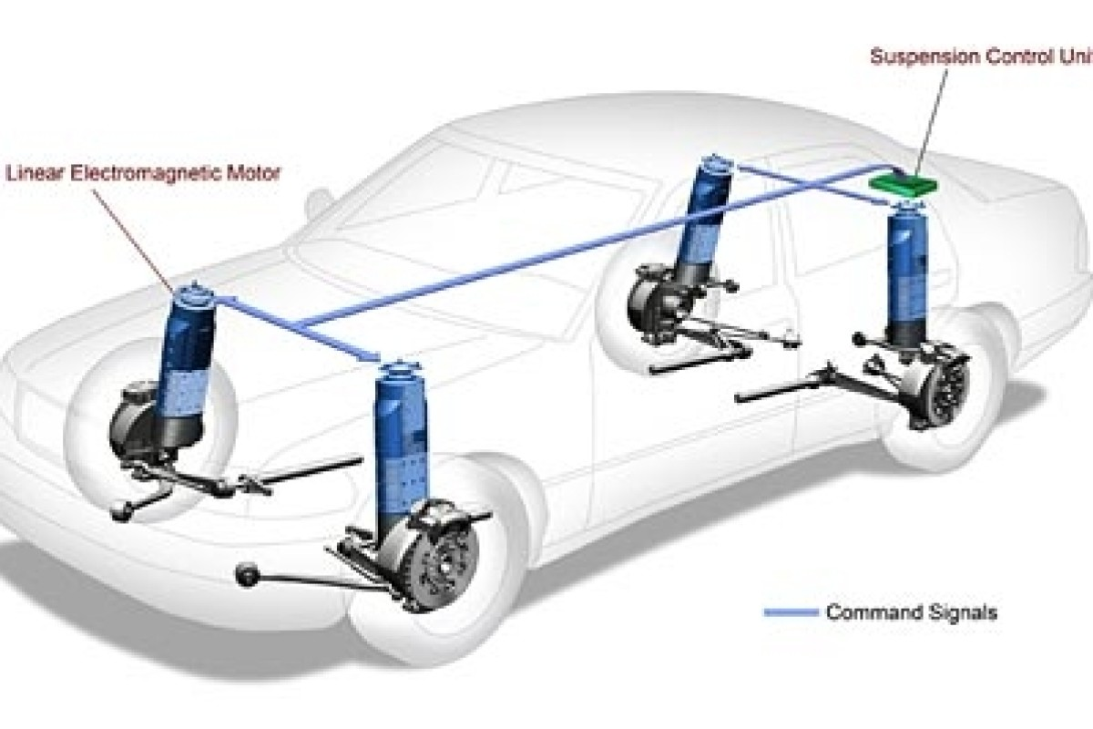
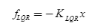
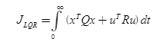
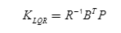
Application : Suspension System
LQR
Force
Performance, expenditure
// Gain matrix
Source: https://www.researchgate.net/publication/322758805_Optimization_of_the_linear_quadratic_regulator_LQR_control_quarter_car_suspension_system_using_genetic_algorithm

Slide 22
References
What is LQR
https://www.youtube.com/watch?v=wEevt2a4SKI
Pole placement technique vs LQR
https://www.mathworks.com/videos/state-space-part-4-what-is-lqr-control-1551955957637.html
Suspension system using LQR
https://www.researchgate.net/publication/322758805_Optimization_of_the_linear_quadratic_regulator_LQR_control_quarter_car_suspension_system_using_genetic_algorithm

Slide 23
H - INFINITY

Slide 24
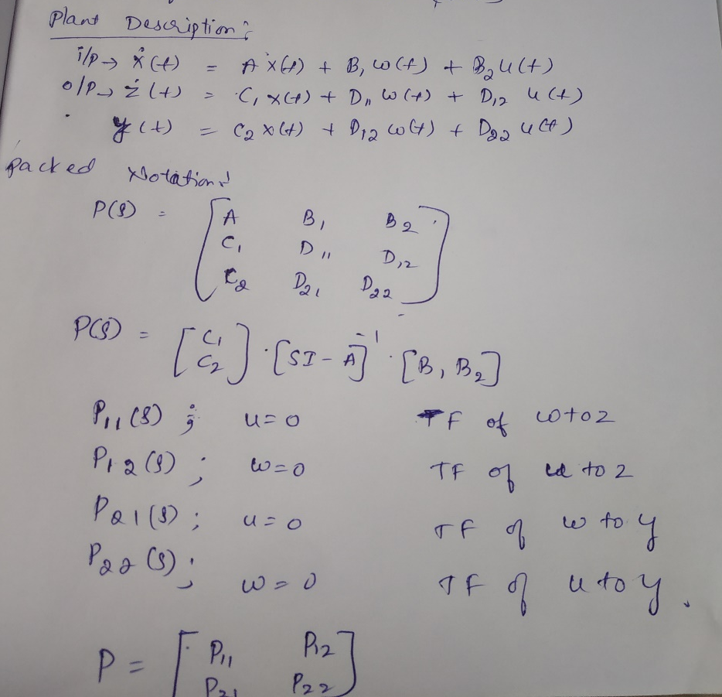
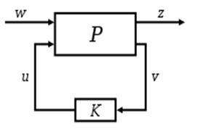
Problem formulation
standard configuration
source: https://en.wikipedia.org/wiki/H-infinity_methods_in_control_theory

Slide 25
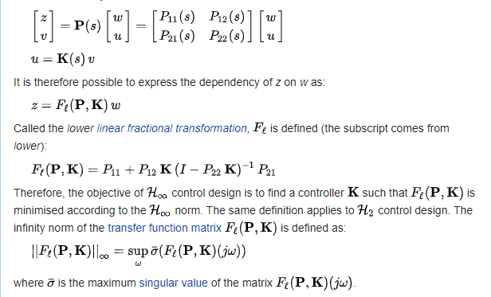
Problem formulation

Slide 26
Advantages and Disadvantages
Advantages
Applicable to problems involving multivariate systems with cross-coupling between channels.
High disturbance rejection.
High stability.
Disadvantages
The level of mathematical understanding

Slide 27
Examples
Explanation of H infinity Problem Solving
https://youtu.be/Loc1HcvQJ5E
Active Suspension System
https://in.mathworks.com/help/robust/gs/active-suspension-control-design.html
Lane Keeping
https://youtu.be/W92vSYRJbug

Slide 28

Thank You !

